Slide 1
Medaille College Department of Education

Slide 2
Dr. Jeff Faunce – Dept. Chair and Program Director

Slide 3
First – a Story!

Slide 4
What is my program?
Pre-K-Elementary Education Early Childhood/Childhood (B-2; 1-6) | BSED | 6/2009 6/2014 | Early Childhood, Birth-2 Childhood, 1-6 | Initial
Adolescent Education and Students with Disabilities (7-12) EXT 7-12 | BSED | 8/2011 9/2015 | Adolescent Education Biology, English, Mathematics & Social Studies (7-12) | Initial

Slide 5
DOE Keys to success:
Come to class!!!!!!!

Slide 6
DOE Attendance Policy
Graduate Courses 7 Classes | Graduate Courses 9 & 10 Classes | Graduate Courses 13-15 Classes | Undergraduate Courses Class Held Twice a Week | Undergraduate Courses Class Held Once a Week
Students who are absent for one class will have their final grade lowered by a full letter grade. | Students who are absent for one class will have their final grade lowered by a half a letter grade. Students who are absent for two classes will have their final grade lowered by a full letter grade. | Students who are absent for two classes will have their final grade lowered by a half letter grade. Students who are absent for three classes will have their final grade lowered by a full letter grade. | Students who are absent for three classes will have their final grade lowered by a half letter grade. Students who are absent for five classes will have their final grade lowered by a full letter grade. | Students who are absent for two classes will have their final grade lowered by a half letter grade. Students who are absent for three classes will have their final grade lowered by a full letter grade.
Students who are absent for two or more classes will be required to retake the course | Students who are absent for three or more classes will be required to retake the course | Students who are absent for four or more classes will be required to retake the course | Students who are absent for six or more classes will be required to retake the course | Students who are absent for four or more classes will be required to retake the course

Slide 7
DOE Keys to success:
Work hard!!!!!!!!!!!!!!
It’s much harder to catch up then it is to keep up!

Slide 8
DOE Keys to success:
Undergraduate students must receive a grade of a C or above for all pedagogical courses. Otherwise the course must be repeated.
Concentration Courses
Undergraduate Early Childhood/Childhood students must receive a grade of a C or above in all concentration courses. Otherwise the course must be repeated.

Slide 9
DOE Keys to success:
Be on time!!!!!!!!!!!!!

Slide 11
DOE Keys to success:
Communicate with your instructors!!!!!!!!!!!!!!!!!!!!!

Slide 12
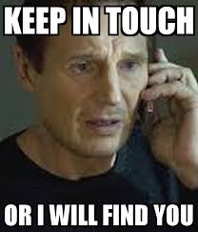

Slide 13
DOE Keys to success:
Communicate with your advisor!!!!!!!!!!!!!

Slide 14
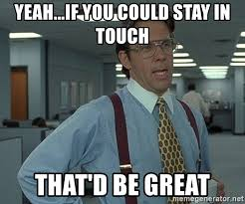

Slide 15
DOE Keys to success:
Use the help that is available!!!!!!!!!!!!!!

Slide 16
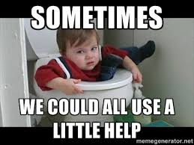

Slide 17
DOE Keys to success:
Get involved!!!!!!!!!!!!
Future Teachers’ Club

Slide 18
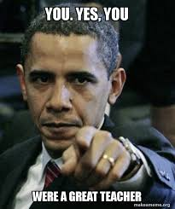

Slide 19
So…what is all this certification stuff?

Slide 20
Steps to Certification
Complete your program
Get fingerprinted
Pass your NYS exams

Slide 21
Certification Exams
EAS – Educating All Students
CST – Content Specialty Test
B-6:
B-2 test
1-6 Test
Adol/SWD
SWD and CST Multi-Subject
CST in Specific Subject (SS, Math, English, Bio)
edTPA
Graduating This year: ATS-W
Everyone else- edTPA (Student Teaching)

Slide 22
Professional Dispositions

Slide 23
Commitment
Exhibits dedication to children and adolescents, developmentally-appropriate teaching, evidence-based instructional methods, social equity, and challenging curriculum
Displays enthusiasm for learning and teaching
Demonstrates ongoing commitment to working with students from diverse backgrounds, ethnicities, and cultures

Slide 24
Responsible Behavior
Attends classes regularly
Arrives on time for classes
Completes assignments on time/meets all deadlines
Uses technology during class for topic-related purposes onl
Employs appropriate language (not profanity or inappropriate gestures)
Identifies and initiates efforts to facilitate learning
Responds to novel problems and situations in creative and responsible ways
Maintains appropriate dress consistent with a professional educational environment

Slide 25
Professional Communication
Cooperates with peers
Receives feedback openly with the goal or personal and professional growth
Articulates perspectives clearly
Differentiates between factual information and personal opinion
Seeks input from peers and instructors
Listens to the perspectives of others
Responds to others (including those with differing perspectives) in a manner that is nonthreatening and promotes dialogue
Communicates in a positive manner that promotes collaboration with peers as well as instructor (verbal and non-verbal)
Uses Standard English in all professional communication (oral or written)
Writes legibly, spells correctly, and uses proper grammar and punctuation

Slide 26
Confidentiality
Maintains discretion in sharing personal information with or about students, parents, and colleagues
Adheres to professional standards and legal statutes pertaining to confidentiality

Slide 27
Honesty/Integrity
Engages in behaviors and actions that reflect positively on the teaching profession
Seeks constructive resolutions to problems
Completes his or her own work (does not cheat, plagiarize, lie, etc.)
Shows respect for self and others

Slide 28
QUESTIONS?

